Slide 1
Journey PPT(Week-4)
Name: - ARKA KUMAR SAHA
Reg ID: - SH7B23109
Room no.: - 07

Slide 2
Day-1
Introduction to Azure Storage and data services.
Creating storage accounts and containers.
Studying about blobs, block and fileshare.
Studying about Azure Data Lake Storage Gen2.

Slide 3
Day-2
Studying about azure file storage and also about storage resource tools.
Learnt about : -
SSIS – SQL server integration service.
SSAS – SQL server Analytical service
SSRS – SQL server reporting service.

Slide 4
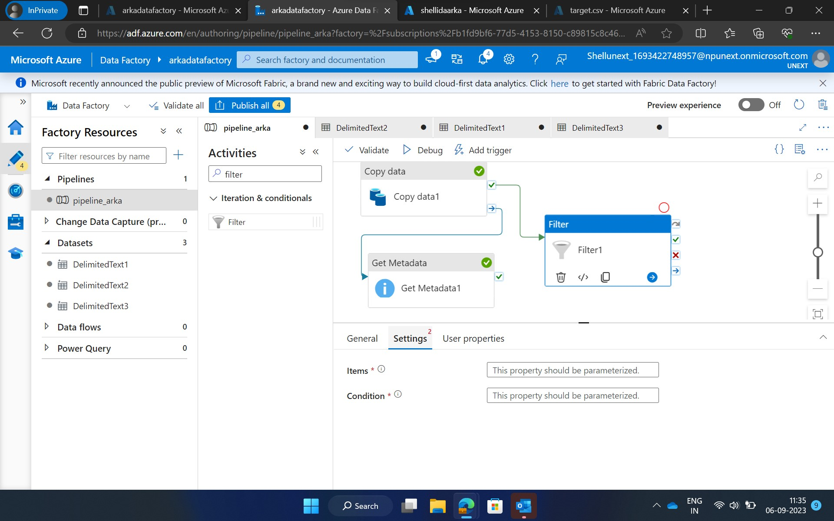
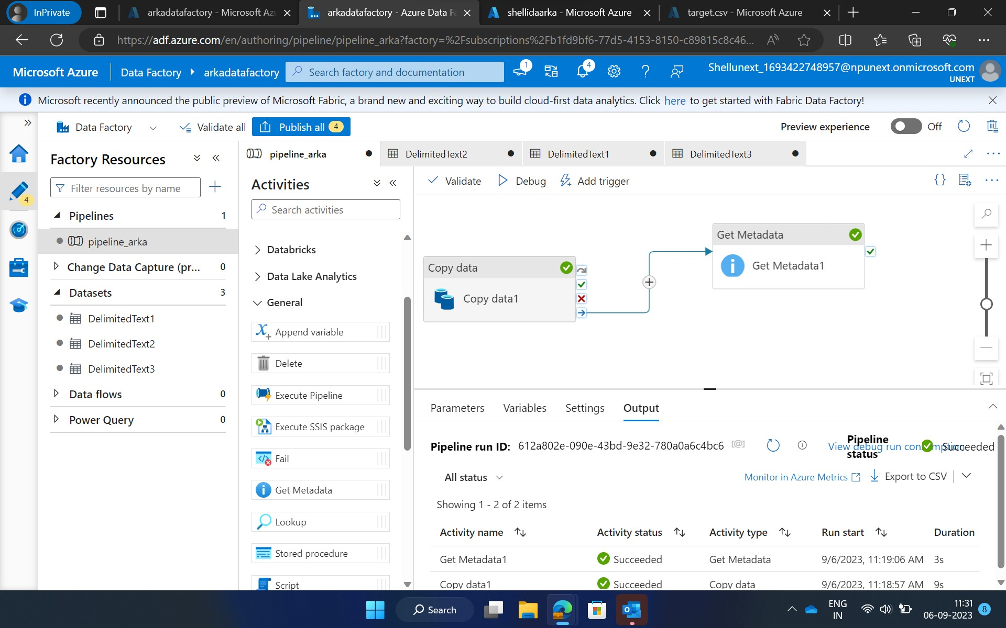
Day-3
Learnt about Data Factory.
Created Pipeline and explored many activities like for each, copy data, filter, etc.

Slide 5
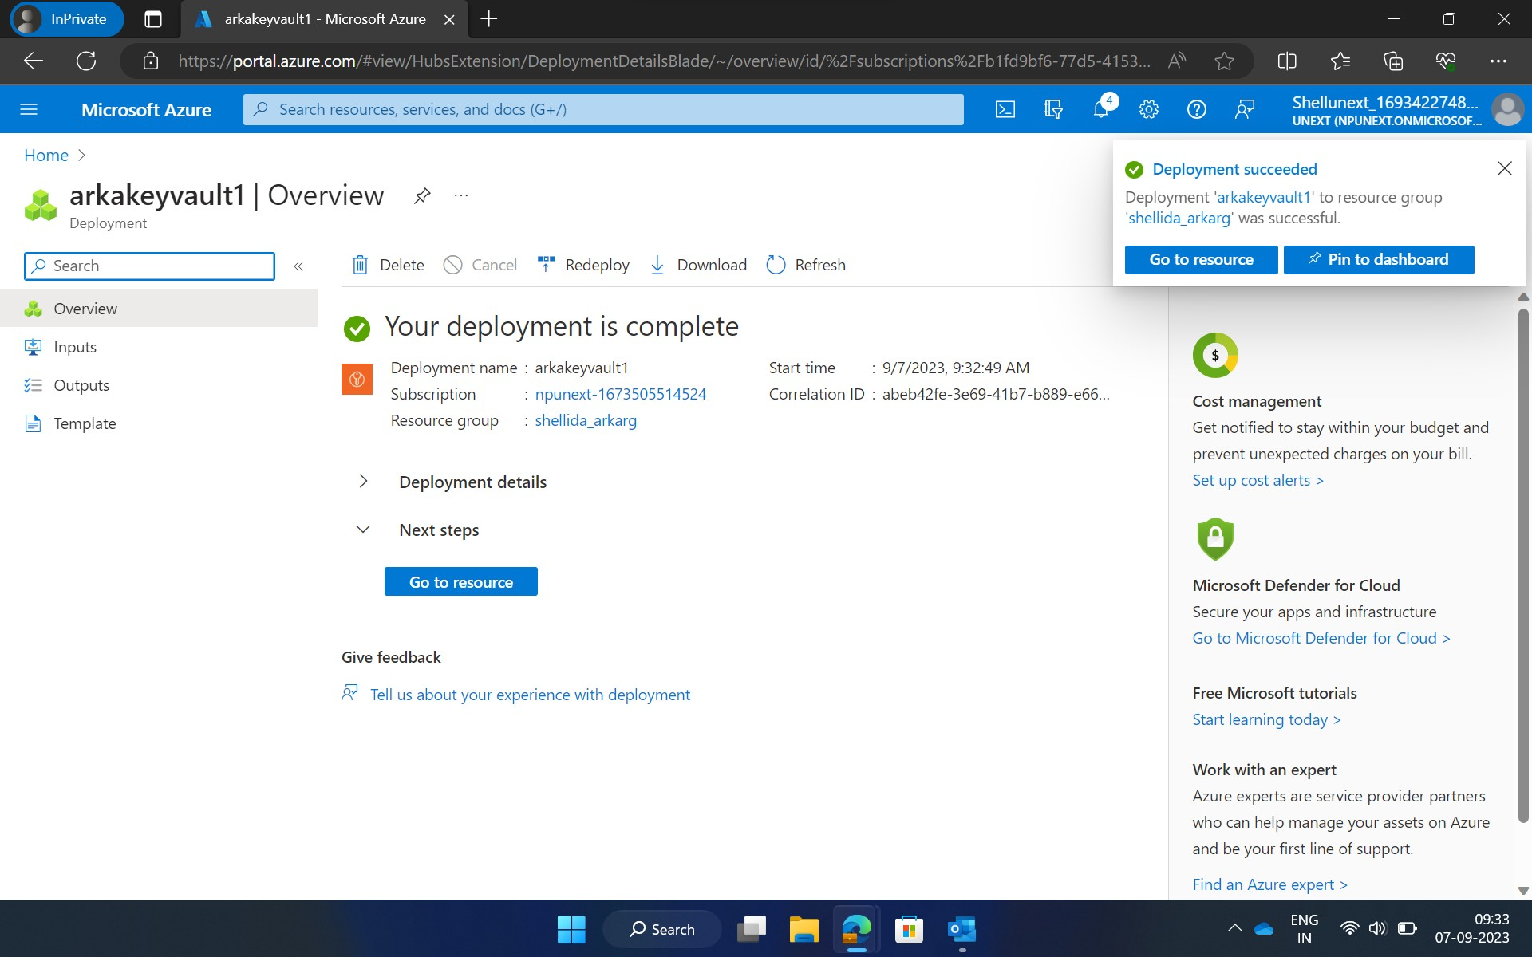
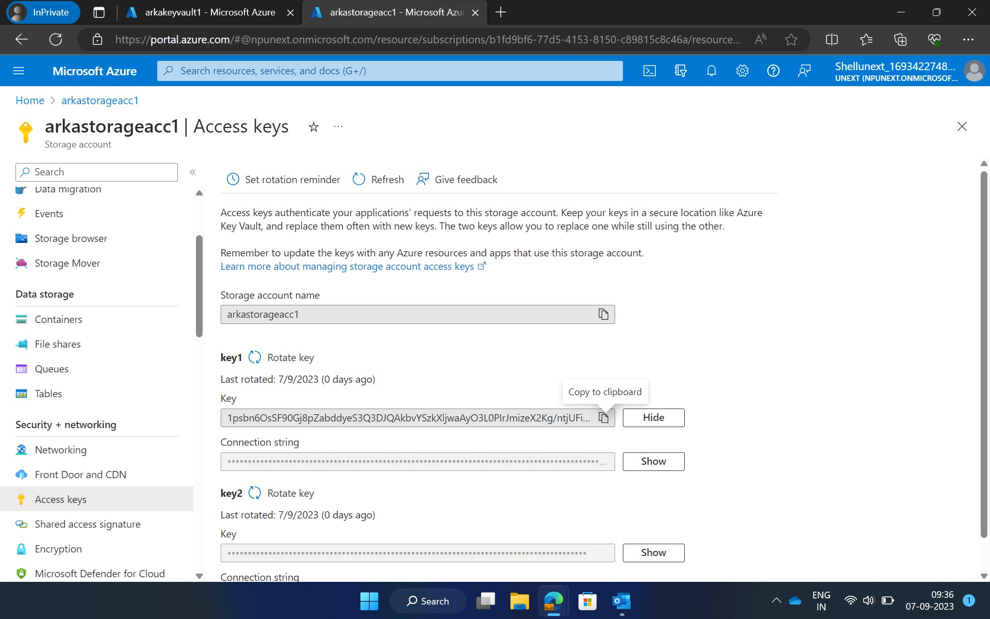
Day-4
Created a key vault.

Slide 6
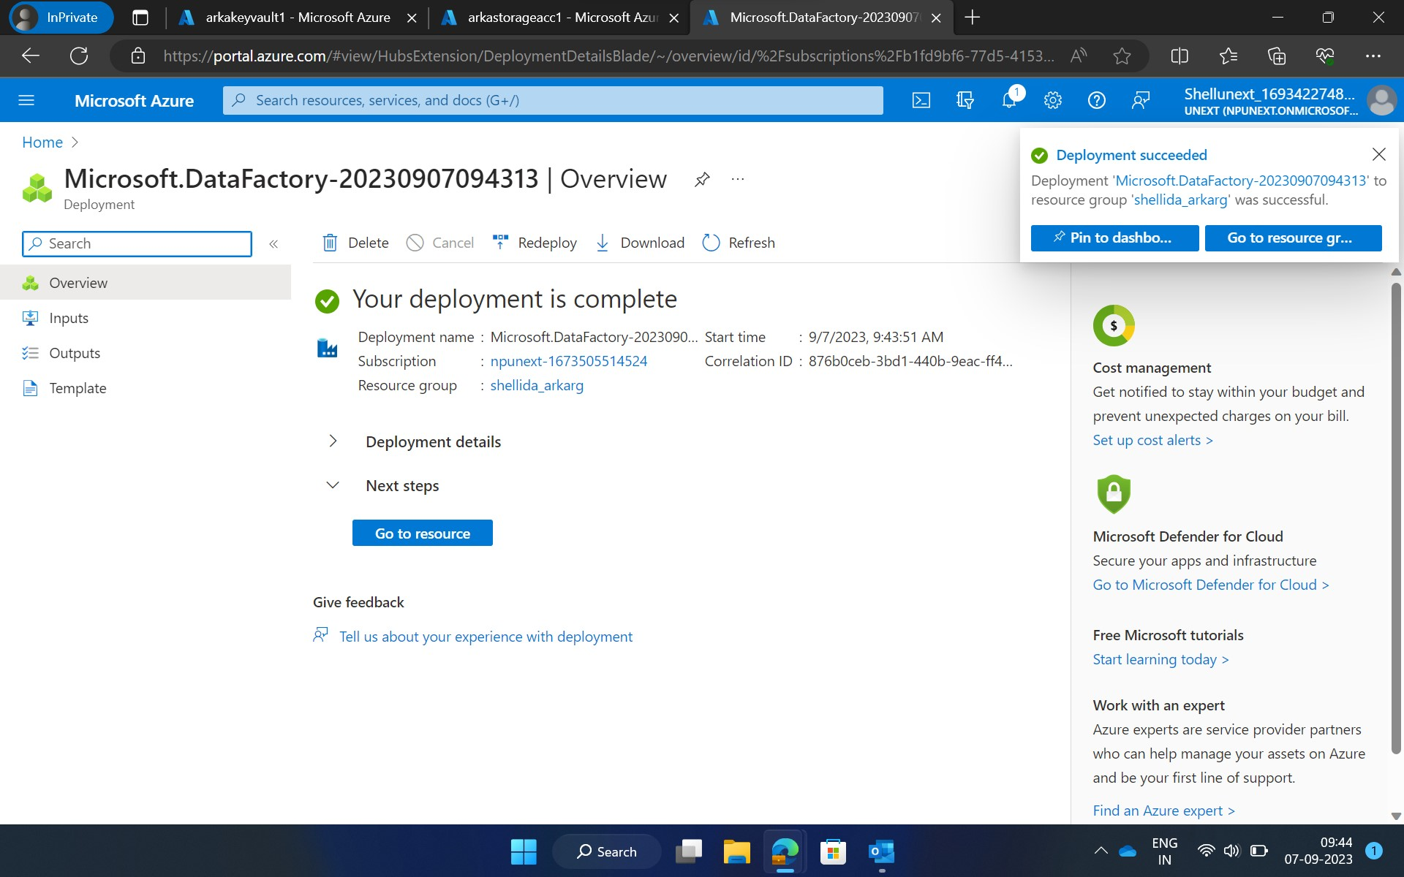
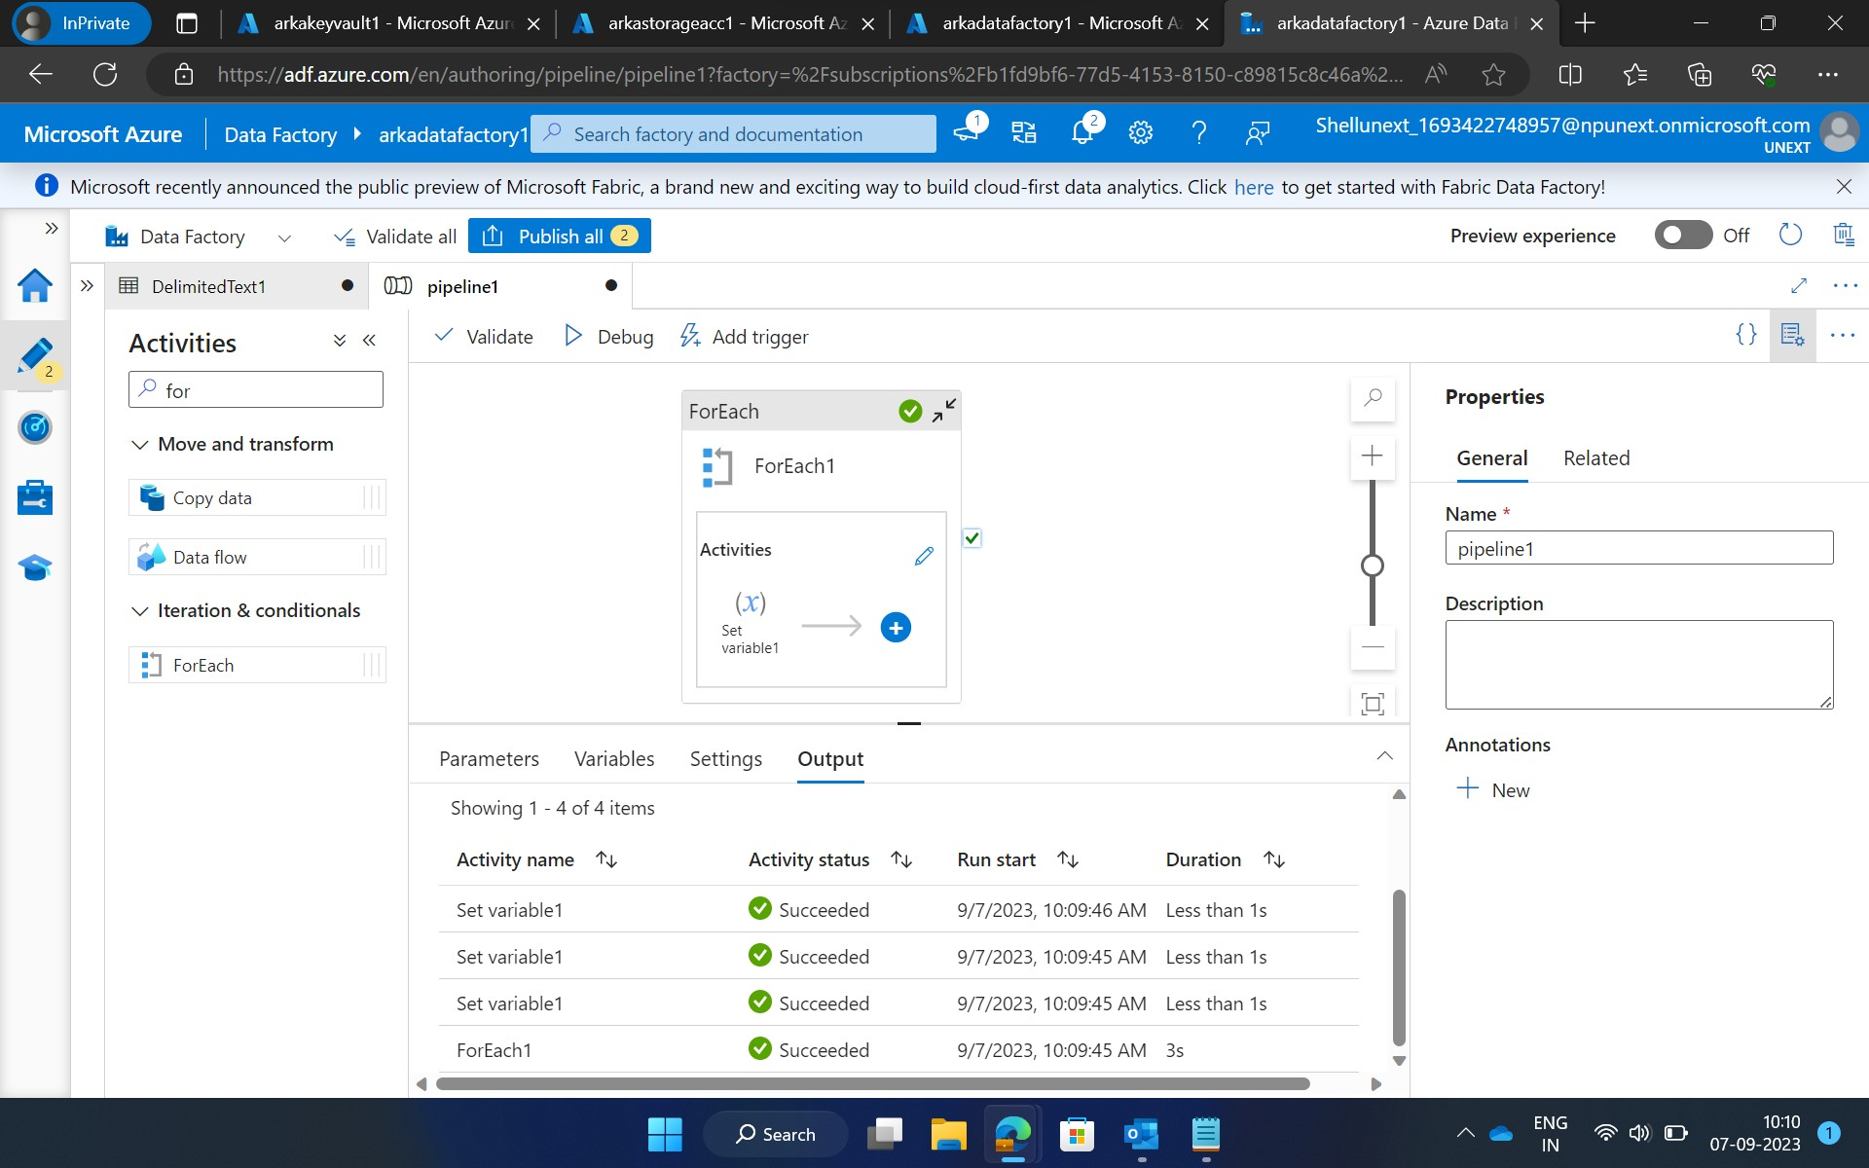
Created a Data factory and a pipeline containing for each activity.

Slide 7
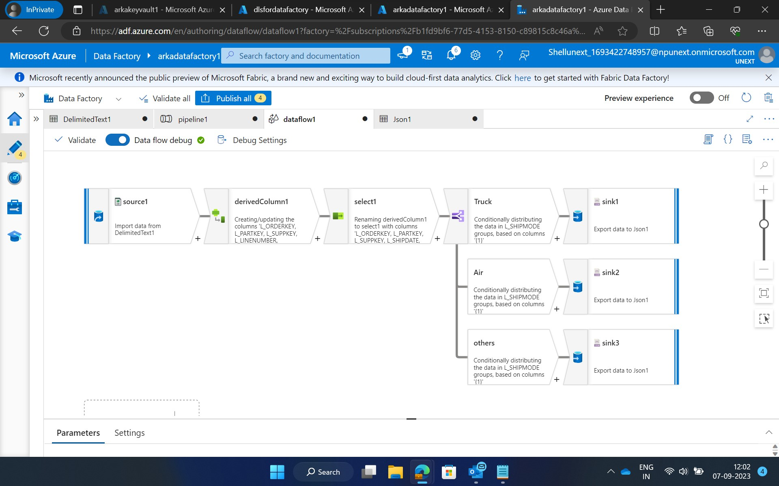

Slide 8
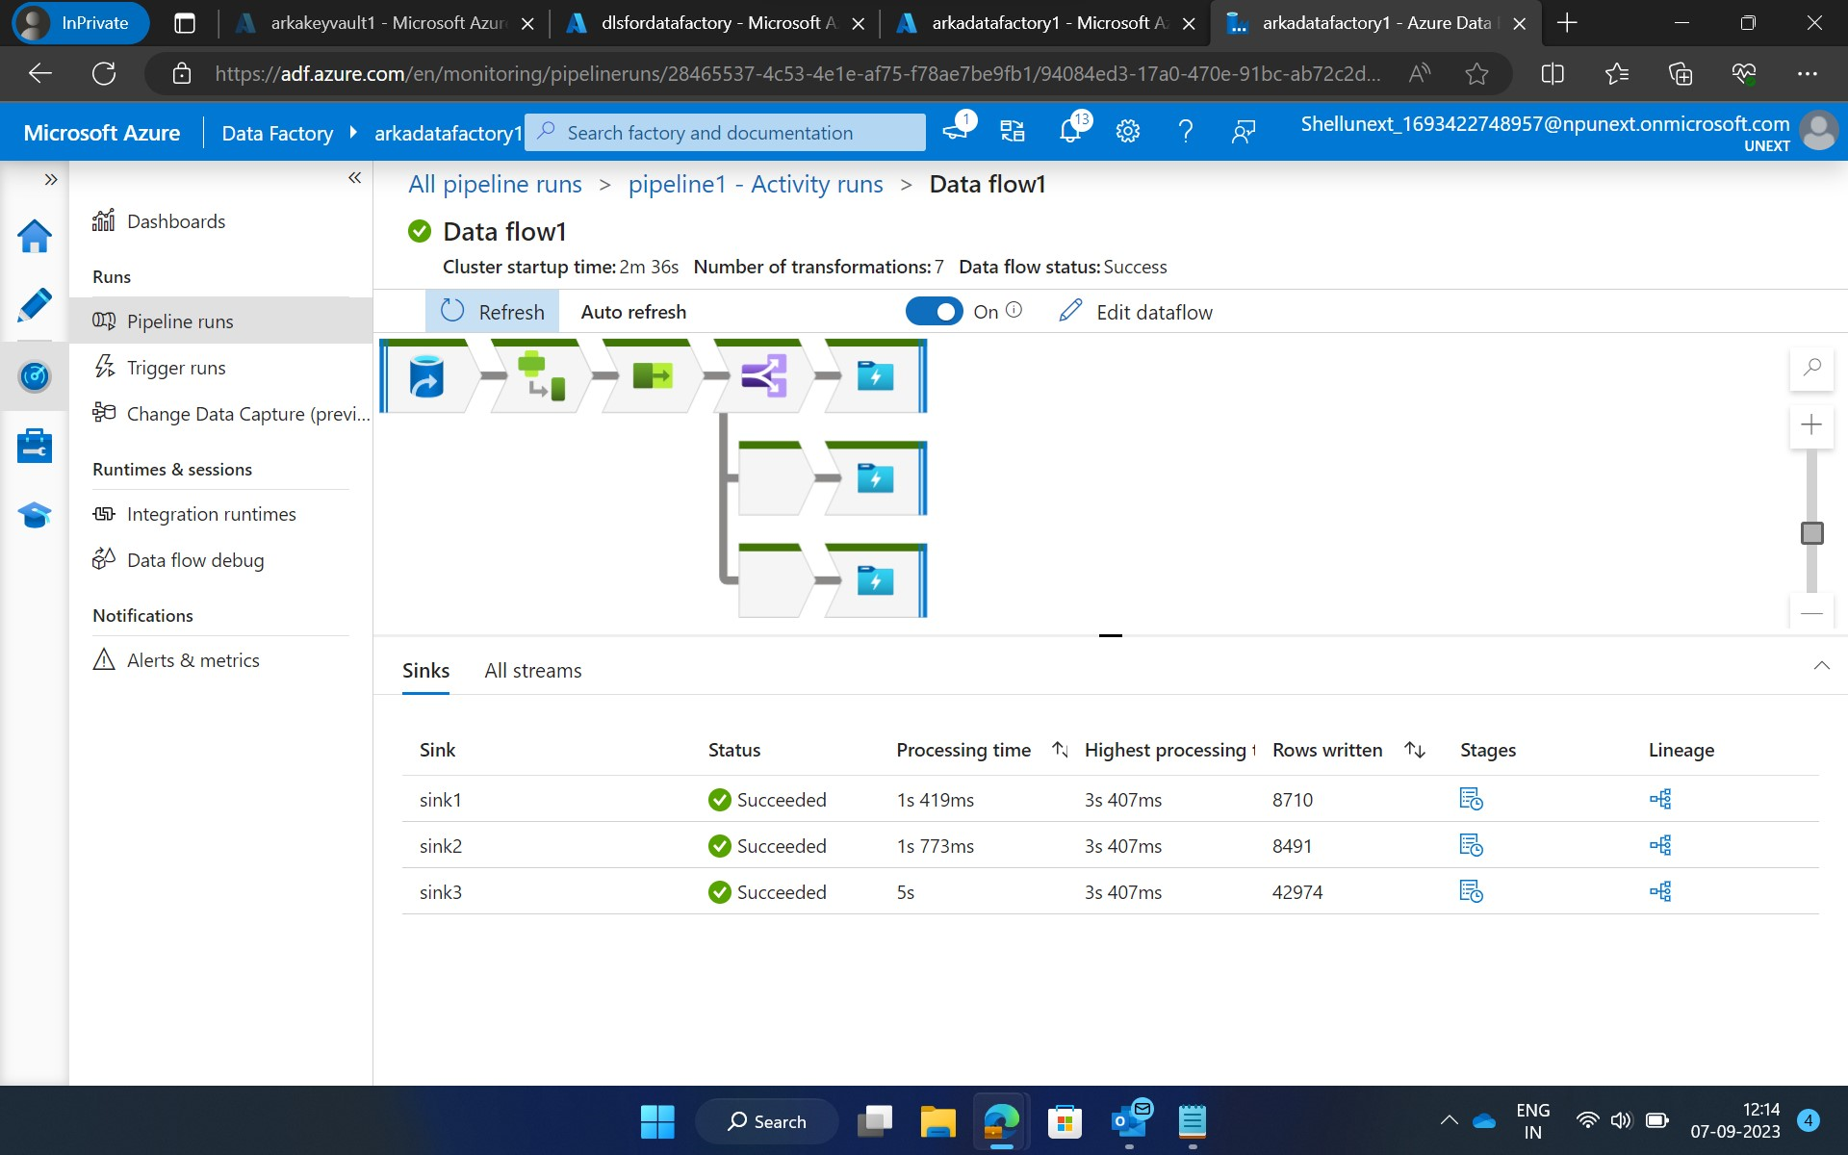

Slide 9
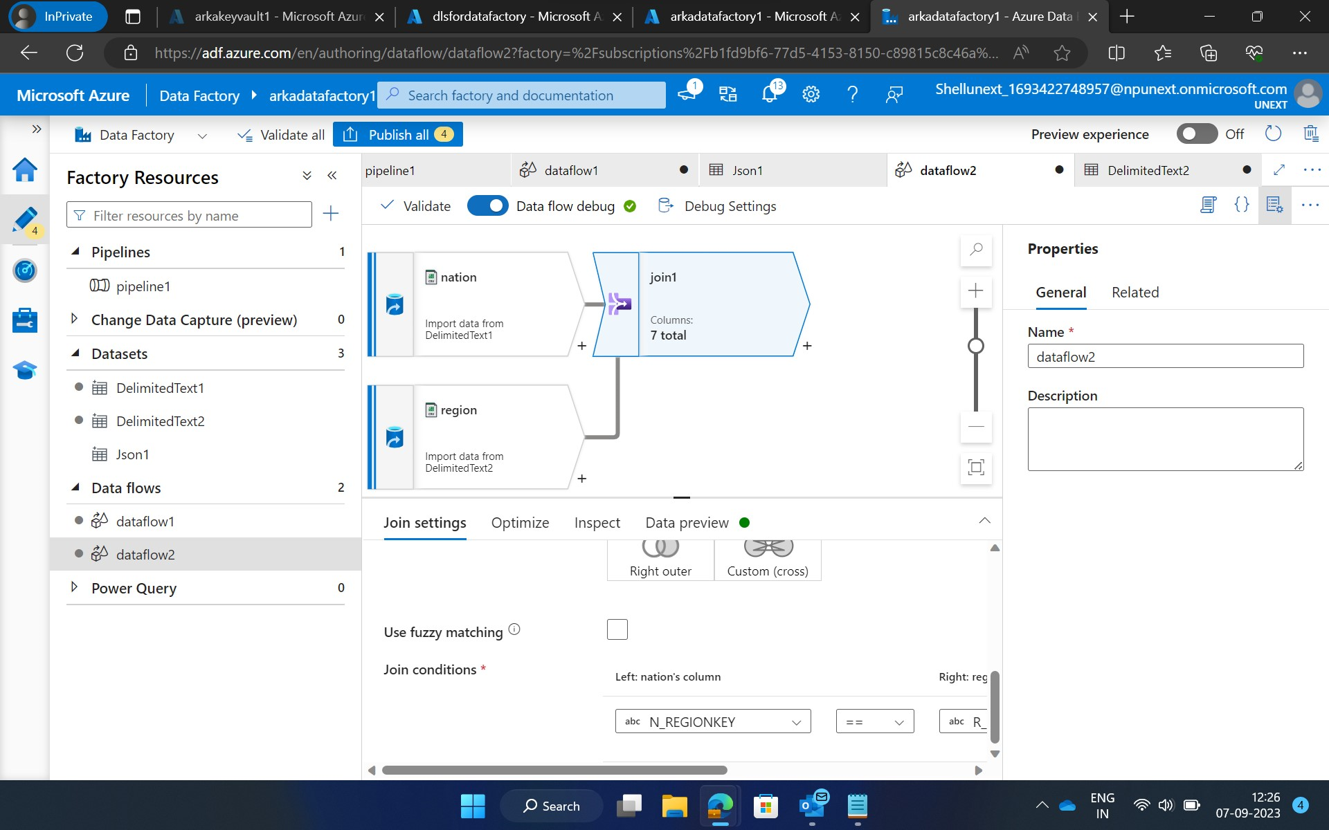
Performed joins

Slide 10
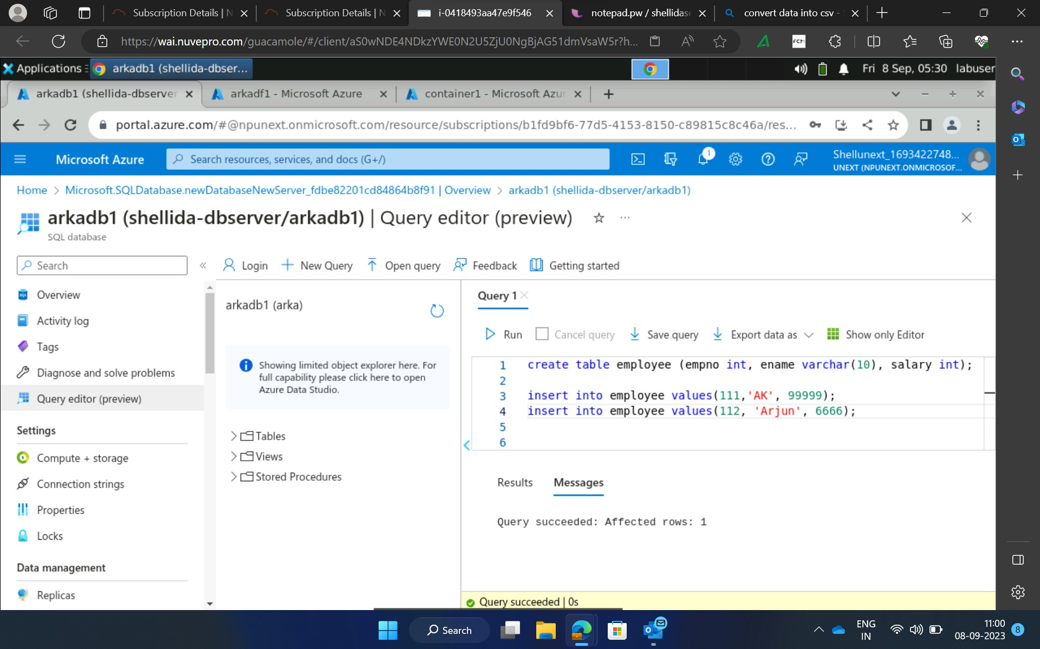
Day-5
Created a storage account, data base server and a data factory and performed various scenarios.

Slide 11
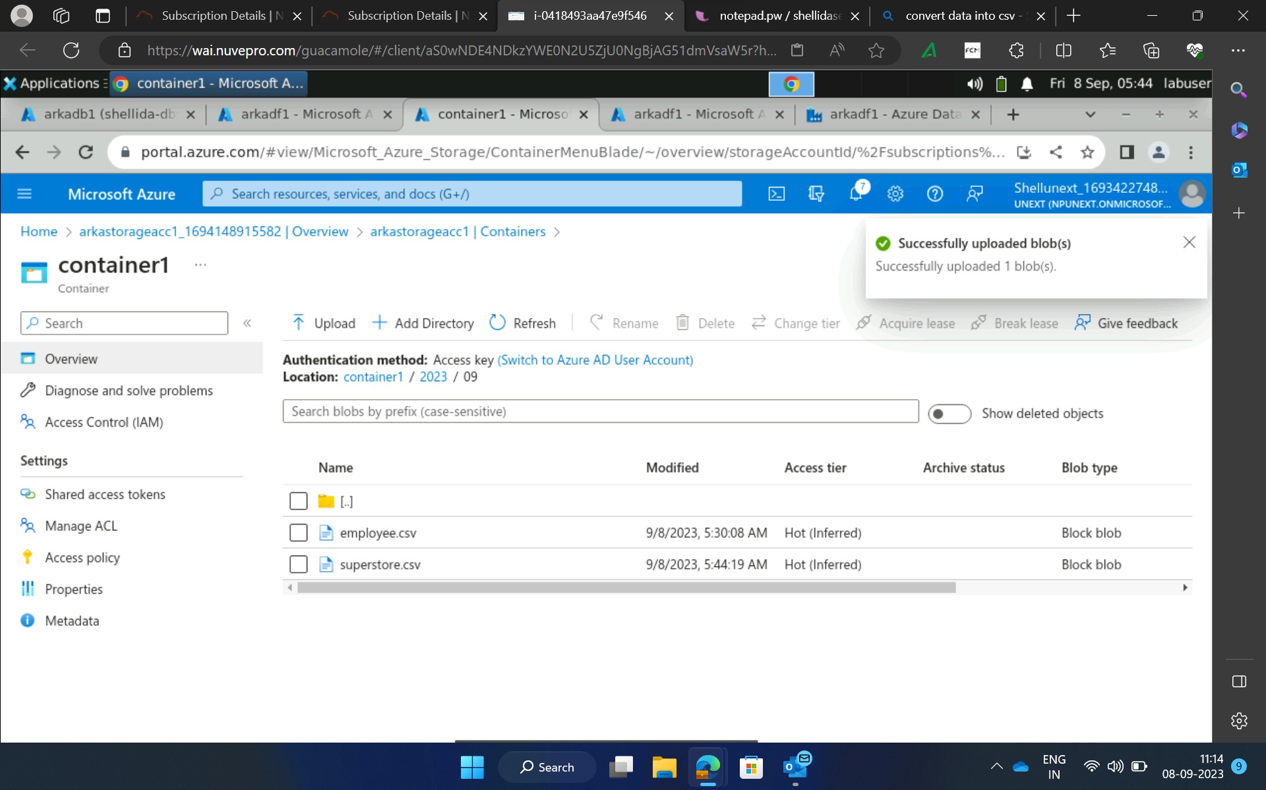
Uploaded 2 files in the container.

Slide 12
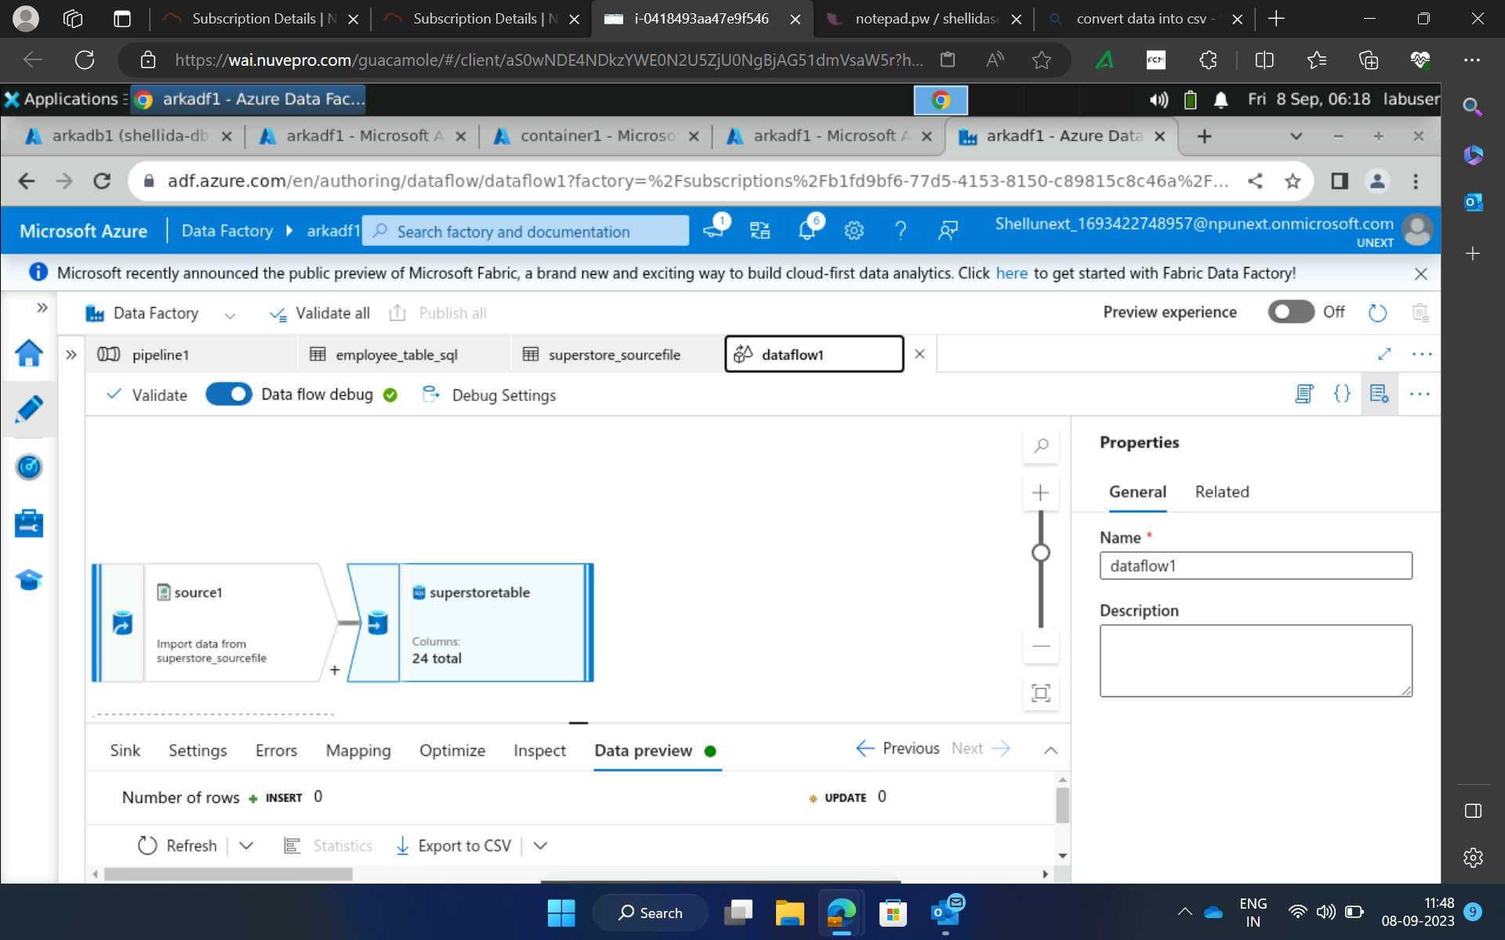
Created a dataflow.

Slide 13
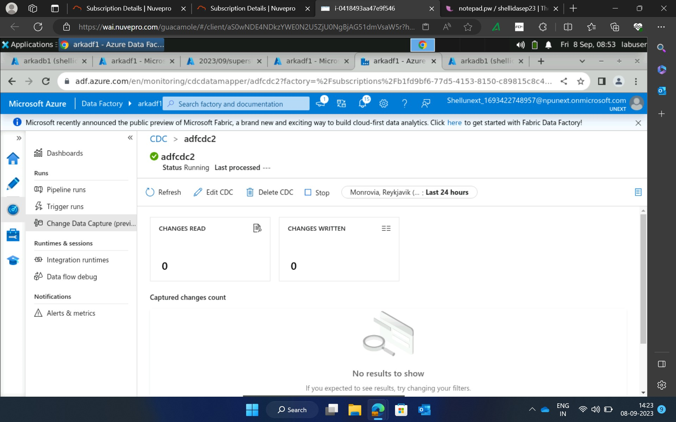
Created a Change Data Capture(CDC)

